Slide 1
5.1 Classifying Loads on Materials
Normal Load (Axial load): Load is perpendicular to the
supporting material.
- Tension Load: As the ends of material are pulled apart
to make the material longer, the load is called a tension
load.
- Compression Load: As the ends of material are pushed in
to make the material smaller, the load is called
a compression load.
Tension
Compression

Slide 2
Classifying Loads on Materials
Shear Load : Tangential load
pulling apart
Cargo
Pressure

Slide 3
Classifying Loads on Materials
Torsion Loads: Angular distortion on a component, such as a
shaft, when a moment is applied. (Twisting)
Thermal Loads: Distortion caused be heating or cooling a
material. A normal load is created when the material is
constrained in any direction in the plane that is constrained.

Slide 4
5.2 Stress and Strain
In order to compare materials, we must have measures.
Stress : load per unit Area
F : load applied in pounds
A : cross sectional area in in²
: stress in psi
A
F
F

Slide 5
Stress and Strain
Strain:
- Ratio of elongation of a material to the original length
- unit deformation
Lo
e
L
e : elongation (ft)
Lo : unloaded(original) length of a material (ft)
: strain (ft/ft) or (in/in)
Elongation:
L : loaded length of a material (ft)

Slide 6
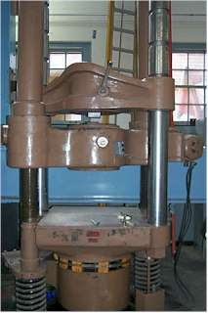
Baldwin Hydraulic Machine for Tension & Compression test

Slide 7
5.3 Stress-Strain Diagram
A plot of Strain vs. Stress.
The diagram gives us the behavior of the material and
material properties.
Each material produces a different stress-strain
diagram.

Slide 8
Stress-Strain Diagram
ultimate
tensile strength
3
necking
Slope=E
Strain
Hardening
yield
strength
Fracture
5
2
Elastic region
slope=Young’s(elastic) modulus
yield strength
Plastic region
ultimate tensile strength
strain hardening
fracture
Plastic
Region
Stress (F/A)
Elastic
Region
4
1
Strain ( ) (e/Lo)

Slide 9
Stress-Strain Diagram
Elastic Region (Point 1 –2)
- The material will return to its original shape
after the material is unloaded( like a rubber band).
- The stress is linearly proportional to the strain in
this region.
or
: Stress (psi)
E : Elastic modulus (Young’s Modulus) (psi)
: Strain (in/in)
Point 2 : Yield Strength : a point at which permanent
deformation occurs. ( If it is passed, the material will
no longer return to its original length.)

Slide 10
Stress-Strain Diagram
ultimate
tensile strength
3
necking
Slope=E
Strain
Hardening
yield
strength
Fracture
5
2
Elastic region
slope=Young’s(elastic) modulus
yield strength
Plastic region
ultimate tensile strength
strain hardening
fracture
Plastic
Region
Stress (F/A)
Elastic
Region
4
1
Strain ( ) (e/Lo)

Slide 11
Stress-Strain Diagram
The ELASTIC Range Means:
- The strain, or elongation over a unit length, will behave linearly (as in
y=mx +b) and thus predictable.
The material will return to its original shape (Point 1) once an applied load
is removed.
- The stress within the material is less than what is required to create a
plastic behavior (deform or stretch significantly without increasing stress).

Slide 12
Stress-Strain Diagram
Plastic Region (Point 2 –3)
- If the material is loaded beyond the yield strength,
the material will not return to its original shape
after unloading.
- It will have some permanent deformation.
- If the material is unloaded at Point 3, the curve will
proceed from Point 3 to Point 4. The slope will be
the as the slope between Point 1 and 2.
- The distance between Point 1 and 4 indicates the
amount of permanent deformation.

Slide 13
Stress-Strain Diagram
ultimate
tensile strength
3
necking
Slope=E
Strain
Hardening
yield
strength
Fracture
5
2
Elastic region
slope=Young’s(elastic) modulus
yield strength
Plastic region
ultimate tensile strength
strain hardening
fracture
Plastic
Region
Stress (F/A)
Elastic
Region
4
1
Strain ( ) (e/Lo)

Slide 14
Stress-Strain Diagram
Strain Hardening
- If the material is loaded again from Point 4, the
curve will follow back to Point 3 with the same
Elastic Modulus(slope).
- The material now has a higher yield strength of
Point 4.
- Raising the yield strength by permanently straining
the material is called Strain Hardening.

Slide 15
Stress-Strain Diagram
ultimate
tensile strength
3
necking
Slope=E
Strain
Hardening
yield
strength
Fracture
5
2
Elastic region
slope=Young’s(elastic) modulus
yield strength
Plastic region
ultimate tensile strength
strain hardening
fracture
Plastic
Region
Stress (F/A)
Elastic
Region
4
1
Strain ( ) (e/Lo)

Slide 16
Stress-Strain Diagram
Tensile Strength (Point 3)
- The largest value of stress on the diagram is called
Tensile Strength(TS) or Ultimate Tensile Strength
(UTS)
- It is the maximum stress which the material can
support without breaking.
Fracture (Point 5)
- If the material is stretched beyond Point 3, the stress
decreases as necking and non-uniform deformation
occur.
- Fracture will finally occur at Point 5.

Slide 17
Stress-Strain Diagram
ultimate
tensile strength
3
necking
Slope=E
Strain
Hardening
yield
strength
Fracture
5
2
Elastic region
slope=Young’s(elastic) modulus
yield strength
Plastic region
ultimate tensile strength
strain hardening
fracture
Plastic
Region
Stress (F/A)
Elastic
Region
4
1
Strain ( ) (e/Lo)

Slide 18
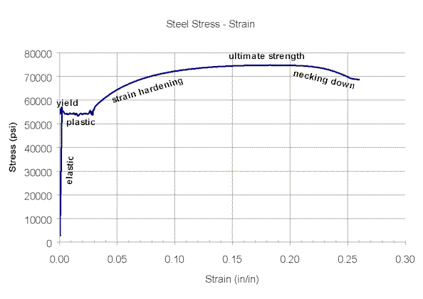
Stress-Strain Diagram
A36 Steel

Slide 19
5.4 Material Properties
Characteristics of Material are described as
Strength
Hardness
Ductility
Brittleness
Toughness

Slide 20
Material Properties
Strength:
- Measure of the material property to resist deformation
and to maintain its shape
- It is quantified in terms of yield stress or ultimate
tensile strength .
- High carbon steels and metal alloys have higher strength
than pure metals.
- Ceramic also exhibit high strength characteristics.
σ_{y}
σ_{ult}

Slide 21
Material Properties
Hardness:
- Measure of the material property to resist indentation,
abrasion and wear.
- It is quantified by hardness scale such as Rockwell and
Brinell hardness scale that measure indentation /
penetration under a load.
- Hardness and Strength correlate well because both
properties are related to inter-molecular bonding. A
high-strength material is typically resistant to wear
and abrasion.

Slide 22
A comparison of hardness of some typical materials:
Material
Brinell Hardness
Pure Aluminum
15
Pure Copper
35
Mild Steel
120
304 Stainless Steel
250
Hardened Tool Steel
650/700
Hard Chromium Plate
1000
Chromium Carbide
1200
Tungsten Carbide
1400
Titanium Carbide
2400
Diamond
8000
Sand
1000

Slide 23
Material Properties
Ductility:
- Measure of the material property to deform before failure.
- It is quantified by reading the value of strain at the
fracture point on the stress strain curve.
- Ductile materials can be pulled or drawn into pipes, wire,
and other structural shapes
- Examples of ductile material :
low carbon steel
aluminum
copper
brass

Slide 24
Material Properties
Brittleness:
- Measure of the material’s inability to deform before failure.
- The opposite of ductility.
- Example of ductile material : glass, high carbon steel,
ceramics
Brittle
Stress
Ductile
Strain

Slide 25
Material Properties
Toughness:
- Measure of the material ability to absorb energy.
- It is measured by two methods.
a) Integration of stress strain curve
- Slow absorption of energy
- Absorbed energy per unit volume
unit : (lb/in²) *(in/in) =lb·in/in³
b) Charpy test
- Ability to absorb energy of an impact without
fracturing.
- Impact toughness can be measured.

Slide 26
Material Properties
Charpy V-Notch Test:

Slide 27
Material Properties
Charpy V-Notch Test:
- Charpy test is an impact toughness measurement test
because the energy is absorbed by the specimen very
rapidly.
- The potential energy of the pendulum before and after
impact can be calculated form the initial and final
location of the pendulum.
- The potential energy difference is the energy it took to
break the material absorbed during the impact.
- Purpose is to evaluate the impact toughness as a
function of temperature

Slide 28
Material Properties
Charpy V-Notch Test:

Slide 29
Material Properties
Charpy V-Notch Test:
At low temperature, where the material is brittle and
not strong, little energy is required to fracture the material.
At high temperature, where the material is more ductile
and stronger, greater energy is required to fracture the
material
The transition temperature is the boundary between brittle
and ductile behavior.
The transition temperature is an extremely important
parameter in selection of construction material.

Slide 30
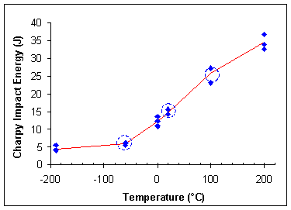
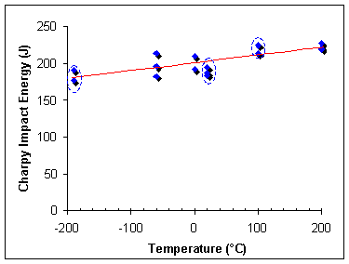
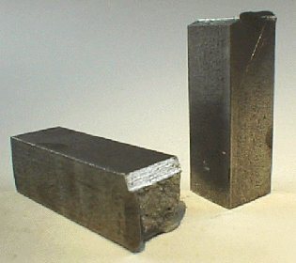
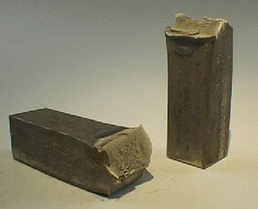
Charpy V-Notch Test:
High Carbon Steel
Stainless Steel

Slide 31
Material Properties
Fatigue:
The repeated application of stress typically produced by
an oscillating load such as vibration.
Sources of ship vibration are engine, propeller and waves.
MAXIMUM stress decreases as the number of loading cycles increases.
Endurance Limit : A certain threshold
stress which will not cause the fatigue
failure for the number of cycles.
Steel
Stress (psi)
Aluminum
Aluminum has no endurance limit
Cycles N at Fatigue Failure

Slide 32
Factors effecting Material Properties
Temperature :
Increasing temperature will:
- Decrease Modulus of Elasticity
(As Long as Structure Does Not Change)
- Decrease Yield Strength
- Decrease Ultimate Tensile Strength
- Decrease Hardness
- Increase Ductility
- Decrease Brittleness
Environment:
- Sulfites, Chlorine, Oxygen in water,
Radiation, Pressure

Slide 33
Ways to Effect / Alter Material Properties
Alloying (Adding other elements to alter the molecular properties):
- Steel: Carbon, chromium, molybdenum, nickel, tungsten, manganese
- Aluminum: Copper, manganese, silicon, zinc, magnesium
Thermal Treatments (Application of heat over varying time):
Annealing:
- Heating higher than its critical temperature then
cooling slowly.
- Improves hardness, strength, and ductility.
- Ship’s hulls are annealed.
Hardening:
- Heating higher than its critical temperature then
cooling rapidly.
- Improves hardness.
- Increases internal stresses, may cause cracking.

Slide 34
Ways to Effect / Alter Material Properties
Thermal Treatments:
Tempering:
- Steel is heated below the critical temperature and
cooled slowly.
- Used with hardening to reduce the internal stresses.
Hot-Working:
- Forming of shapes while material is hot.
- Less internal stresses due to annealing (change in
the molecular structure).
Cold-Working:
- Forming shapes while material is cold.
- Causes internal stresses, resulting in a stronger shape.

Slide 35
Corrosion & Corrosion Protection
Corrosion is the destruction of metals due to oxidation or
other chemical reactions.
Corrosion Protection:
- Design to eliminate conditions favorable to corrosion
- You, a wire brush, and paint
- Cathodic Protection
- Charging the metal to slow/ stop reaction
with other elements
- Providing a sacrificial metal to give up ions
instead of the structure giving up ions (and
corroding)

Slide 36
Example:
Mooring line length =100 ft
diameter=1.0 in
Axial loading applied=25,000 lb
Elongation due to loading=1.0 in
mooring line
1) Find the normal stress.
loading
2) Find the strain.

Slide 37
Example:
- Salvage crane is lifting an object of 20,000 lb.
- Characteristics of the cable
diameter=1.0 in, length prior to lifting =50 ft
1) Find the normal stress in the cable.
2) Find the strain.
3) Determine the cable stretch in inches.

Slide 38
5.5 Non-Destructive Testing (NDT)
Three Main Types of NDT in Naval Architecture:
  Welding/Brazing/Surface-Subsurface Inspections
  Hydrostatic
  Weight Test

Slide 39
Non-Destructive Testing (NDT)
External Tests
Visual Test (VT)
- Naked Eye or Optical Inspection.
- Always done before other NDT’s.
- Often only NDT required.
Liquid (Dye) Penetrant Test (PT)
- A liquid penetrant and developer are applied
to the test item surface, causing a color change
where surface cracks or flaw exist.
Magnetic Particle Testing (MT)
- The test item is magnetized, then metal particles
are applied to the inspection surface. The particles
will line up along a surface or near surface crack/flaw
giving a visual indication of size and location.

Slide 40
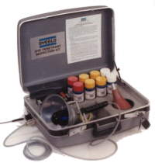
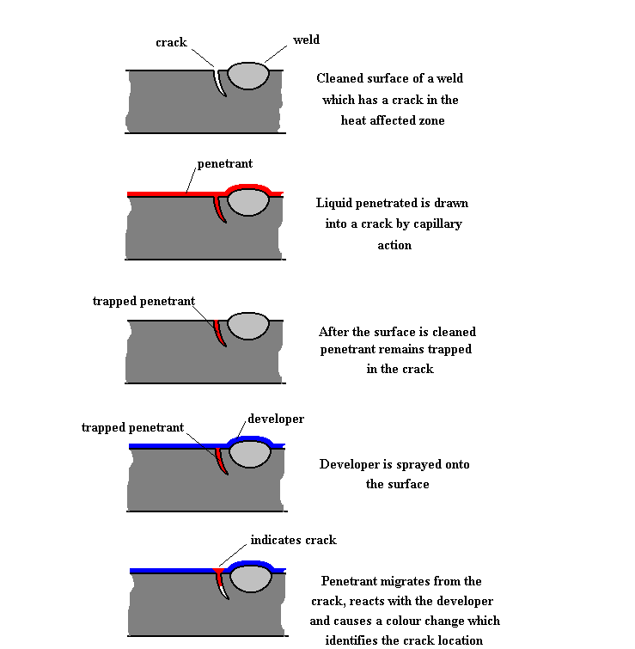
Dye Penetrant Test (PT)
For ferrous and non-ferrous material.
Used on most welded joints.
Followed by radiographic test if required.

Slide 41
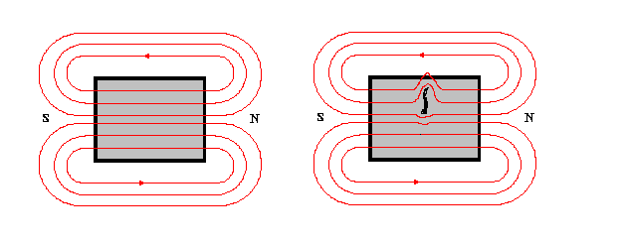
Magnetic Particle Test (MT)
Method that can be used to find surface and near surface
flaws in ferromagnetic materials such as steel and iron.
The technique uses the principle that magnetic fields
(flux) will be distorted by the presence of a flaw.
For ferrous material only.
Used on most structural welds.
Followed by radiographic test if required.

Slide 42
Non-Destructive Testing (NDT)
Ultrasonic Testing (UT)
- A transducer sends ultrasonic waves into the material.
Time and distance is displayed on the oscilloscope.
      Reads material thickness.
      Identifies bonding in silver brazes.
      Shows shear wave for flaws in plates.
Radiographic Testing (RT)
- Uses X-ray or gamma ray to record a permanent image
on file or a photo-reactive plate for interpretation.
- Detects flaws, breaks, or gaps in materials.
Eddy Current Testing (ET)
- Uses magnetic ultra sound to produce eddy currents in a
material to detect surface cracks. Results displayed on
oscilloscope.
- Used only for acceptance, not for final rejection.

Slide 43
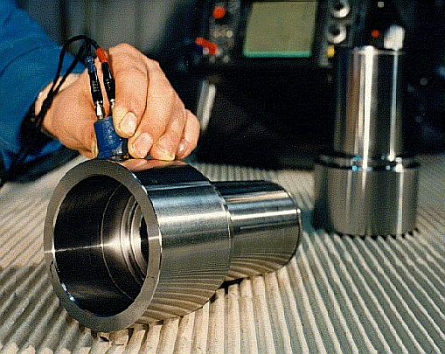
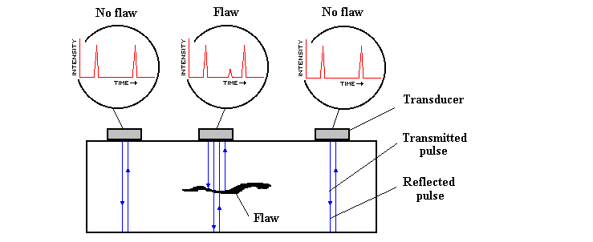
Ultrasonic Test (UT)
Can be used on all metals and nonmetals.
Excellent technique for detecting deep flaws in tubing, rods, adhesive-joined joints.
It is used on aircraft to detect structural cracks.
Needs trained technician to interpret the results.

Slide 44
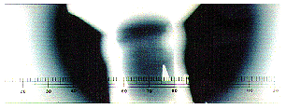
Radiographic Test (RT)
RT requires trained technicians.
RT may have large effect on ship access and watchstanding.
The picture shows the integrity of welding
for the 2.5mm thick steel plate

Slide 45
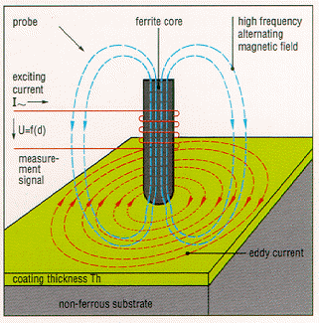
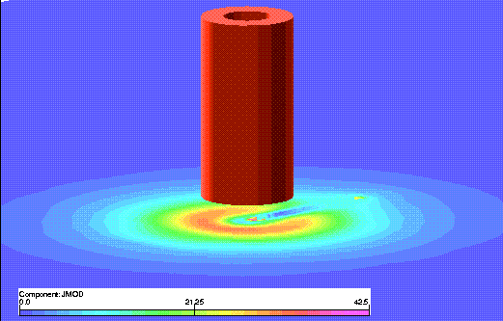
Eddy Current Test (ET)
Elliptical Crack
Detects cracks on both ferromagnetic and non-ferromagnetic materials.
If rejected, verification required by:
  Magnetic Particle Test for ferrous materials.
  Liquid Penetrant Test for non-ferrous materials.

Slide 46
Hydrostatic Tests
Some Systems Subjected to Hydrostatic Testing:
  Drainage Systems
  Firemain/Flush/Seawater Circulations Systems
  Steam Systems
  Compressed Air Systems
  Fuel Systems
  Hydraulic Systems
  Feed/Condensate Systems
  Fresh Water Systems
  Sewage Systems
Subjected to Hydrostatic Testing:
  Valves
  Piping
  Heat Exchangers
  Pumps
  Mechanical Connections
  Flasks

Slide 47
Hydrostatic Tests
Fluid systems are hydrostatically tested during initial construction, and subsequent to repairs, modifications, and component replacement; to verify the leak tightness of the system.
Operational pressure tests are performed periodically to determine leak tightness of system mechanical joints.
Operational pressure tests are also performed instead of hydrostatic tests, when the criteria for the Operating Pressure Test Option are met.
The basic purpose of all such tests is to ascertain that the system can perform its intended function safely and reliably.

Slide 48
Hydrostatic Tests
Generally, the sequence for testing is:
a. Establish required prerequisites and initial conditions.
b. Align the system for testing.
c. Pressurize the system slowly and incrementally.
d. Check for leaks at normal operating pressure and two lower incremental pressures.
e. Continue to increase pressure to hydrostatic test pressure.
f. Perform required inspections.
g. Depressurize, remove temporary equipment, and restore the system to the conditions required for subsequent evolutions.

Slide 49
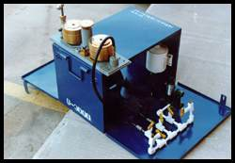
Hydrostatic Tests
Typical Test Requirement:
Must hold 135% of system
design pressure for 30 minutes,
followed by visual inspection.
The criterion for an acceptable hydrostatic test is there shall be no leakage or permanent deformation of pressure-containing parts, as determined by visual examination, except:
The leakage does not become hazardous to personnel.
b. The leakage can be adequately contained to protect equipment.
c. The leakage is within the capacity of the hydrostatic test pump to maintain pressure throughout the test.

Slide 50
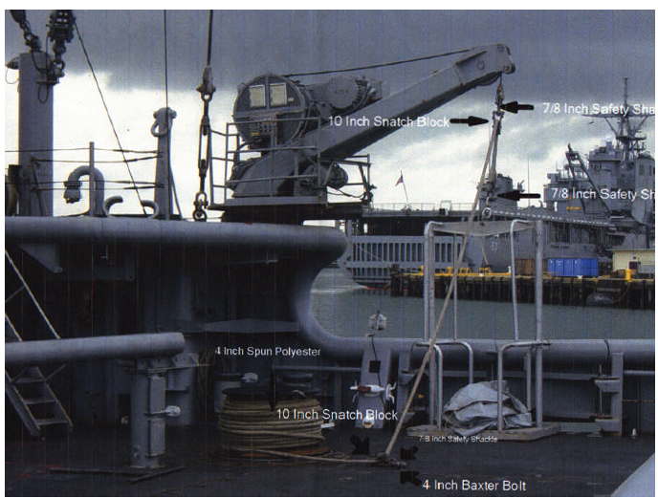
Weight Tests
Purpose is to test weight handling
equipment
Applicable to all weight handling
equipment
Examples of weight handling
equipment:
- Ordnance Handling Equipment
- Underway Replenishment Equipment
- Shipboard Stores and Provision Handling Equipment
- Hull Fittings, Lashing Gear, and Access Closures
- Hoist, Chain Falls, Hook and Trolley Suspensions
- Cranes, Davits, Booms
- Wire and Fiber Rope and Rigging
- Strongbacks, Shackles, Blocks, Yokes, Straps, and Slings
- Elevators

Slide 51
Weight Tests
General Procedure (Correct all deficiencies prior to going on to the next step)
  Pre-Test Inspection
    Visual Inspection
      Foundations, Mounts, Controls, Rigging, Couples, Safeties, Hydraulics, Motors, Pumps, etc
    Operational Test
      Check Operating Parameters, Leaks, Safety Shutdowns, etc
  No-Load Test
      Look for Damage, Operating Temperatures, and Brake Adjustment
  Rated Load Test
      Ensure equipment operates at rated conditions without overheating or other failures
  Static Load Test
      Checks for safeties at conditions above rated load
        Structural Integrity, Brakes, Ratchet and Pawls
      Do not use equipment being tested to lift the static overload
      Typical test is 150-220% of rated load for 10 minutes.
  Dynamic Overload Test
      Test ability of equipment to operate with overload.
      Typically test if ~125-150% of rated load.
Note: Above values are for pier side testing. If at sea the requirements for the static and dynamic testing are reduced, however the rated load is also reduced.

